Slide 1
Introduction
to Paddle-Ability
Tutor Name

Slide 2
Aims and Objectives
Develop an understanding around the challenges faced by paddlers with a disability in terms of accessing sport
Develop an understanding of how our sport can be made more appealing to paddlers with a disability
Develop appropriate communication techniques
Introduction to range of impairments for people accessing paddlesport
Start to consider how to plan and support paddlers with a disability.

Slide 3
Disability in our Society
Definition of disability under the Equality Act 2010: Someone is disabled under the Equality Act 2010 if they have a physical or mental impairment that has a 'substantial' and 'long-term' negative effect on their ability to do normal daily activities.
11 million people in the UK have a disability.
disabilitysport.org
Notes:
Show this slide to demonstrate the extent of the population with a disability
Talk about what the legal definition of a person with a disability
Explain that the prevalence of disability increases with age
If people ask about specifically dedicated schools, this might be a chance to say that fewer and fewer young people attend specifically dedicated schools and as many young people as possible are placed in mainstream schools with additional support put in place.
Opportunity to talk about how many people with a disability are in the workplace and therefore, the financial implications for people with a disability .
Start to talk about hidden disabilities where someones impairment may not be directly obvious

Slide 4
Different Disabilities
;
1 in 4 British adults experience at least one diagnosable mental health problem in any one-year, and one in six experience this at any given time.
Around 700,000 people may have autism, or more than 1 in 100 of the UK population.
There are 1.86 million people in the UK who are blind or partially sighted.
1 in 7 people in the UK (9 million) are Deaf or hard of hearing (14%).
Around 1.5 million people in the UK have a learning disability
(NHS UK).
577,000 people in the UK receive benefits as a result of mobility impairment.
Notes:
Briefly outline the range of impairments that might affect an individual
Use this an opportunity to highlight that when we talk about people with a disability, we often automatically think of wheelchair users. However, only 5% of people with a disability are wheelchair users and only 38% of those wheelchair users are under the age of 65.
An opportunity to talk about acquired or congenital impairment
You can also use the club and centre disability data in the Tutor resources to discuss which impairment groups different clubs/centres are more likely to encounter

Slide 5
People with a disability participating in Sport
Notes:
Discuss the low prevalence of people participating in sport and the implications this has on their general health and well being.
Show that there is a demand and say that today we are going to discuss what we can do to make the opportunities more obvious and appealing.

Slide 6
Paddle-Ability Sociability Film
Notes:
Before the film, talk about perceptions of disability and the activities people might be able to access
After the film, ask the participants on their thoughts in terms of the people included in the film
Video can be found on following link -
https://www.youtube.com/watch?v=OKx66MepxWo&feature=youtu.be&fbclid=IwAR0Kgm1PhjIun-2SQLQK4_NFz7Z3CyvnNadpz4KzU0lACx96ERw7TdnugdY

Slide 7
Accessing our sport
In groups, take a few minutes to discuss what barriers you think paddlers with a disability face in terms of accessing paddlesport.
Notes:
This is an opportunity for groups to discuss what they think the barriers are, once they have spent a short time discussing what they think the barriers are get them to feedback. Do these aline with the real barriers? Use the British Canoeing Awarding Body Paddle-Ability research and the ‘EFDS Me Too’ Research contained in your Tutor pack for your own reference.

Slide 8
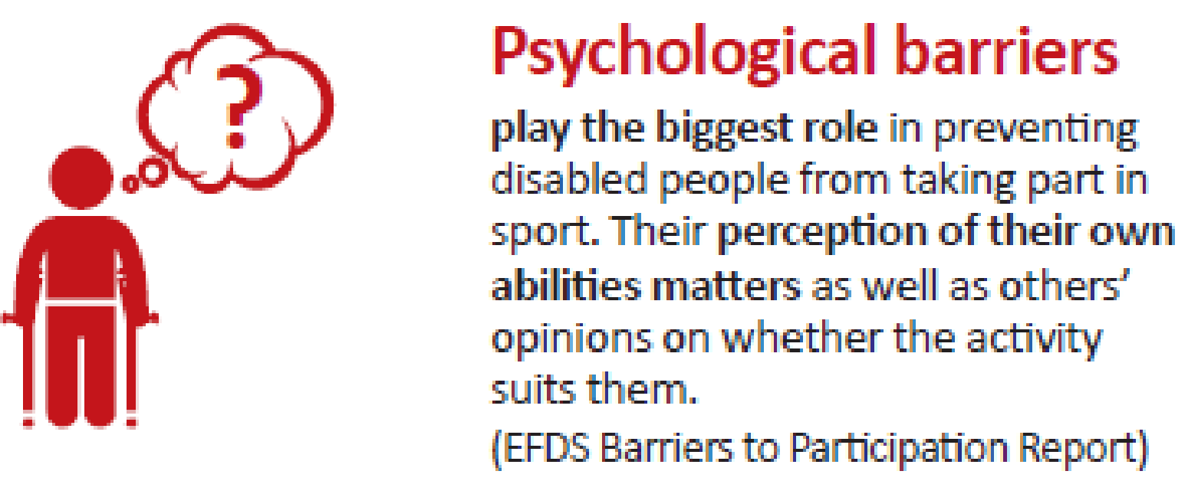
Barriers
Paddlers with disabilities told us the following, did these match your discussions?
Unaware of local opportunities
Lack of accessible clubs
Lack of access to equipment
Lack of qualified instructors who know my needs
Safety concerns / fear of capsizing
No transport to clubs
Perceived lack of skill / ability, e.g. controlling the paddles or getting into a boat
Bad childhood experiences
Financial constraints
Google ‘Disability Paddlesport’ or Disability Sport in your area, what comes up?
Have a look at your club / centre website. Would a paddler with a disability be able to identify they are welcome?
Notes:
These are paddlers with a disability perceptions of challenges: is part of the challenge overcoming people's perceptions? How do we do this?
Use the British Canoeing Awarding Body Paddle-Ability research and the ‘EFDS Me Too’ Research contained in your Tutor pack for your own reference.

Slide 9
How can we limit these barriers?
In your groups, discuss what you could do to overcome or prevent these barriers.
Notes:
Support the participants to come up with their own solutions to overcoming their barriers in their delivery environment. Use the British Canoeing Awarding Body Paddle-Ability Research for reference and ‘EFDS Talk to Me’ research.

Slide 10
Inclusive Communication Film
Notes:
If you have got through the first activities quickly, use this film to give information about creating inclusive communications. If you are running out of time, highlight a quick overview and reference the EFDS guidance. This can go out in your useful links in your follow up email after the course.
Use EFDS Inclusive Comms film and booklet (included in your Tutor pack) for reference.
Video can also be found - https://www.youtube.com/watch?v=XGcoCZa-a50

Slide 11
Accessible Facilities
Have a quick think about your journey here today. How easy was it to get from your front door to the room you are sitting in right now? What challenges might a paddler with a disability have had?
Notes:
This is an opportunity for participants to think about the additional challenges a person with a disability might have faced getting to the venue and then once they are in a venue. Reference the Access Checklist that clubs and centres can use to assess how they are doing. Highlight that no one is expected to have everything in place all at once but that it is a good idea to have a plan in place. Also use the EFDS Accessible Facilities document for your own reference and ensure a link is included in the follow up email for attendees.

Slide 12
Terminology
In groups, sort out which bits of terminology are acceptable and which are not.
Notes:
Assess if you think your group need this (it can vary!). This is an opportunity to highlight that language can vary greatly between groups and people of different ages.

Slide 13
How Disability Affects Different People
In groups, move around the room and try each of the activities.
Notes:
This is a good opportunity for the people in the group to understand some of the challenges people might face. While this is a classroom based activity, as you move around, ask attendees how they feel this might affect activity on the water and what the implications of this might be.
While not specific to our sport, you can use the disability specific resources in the resource pack for reference.

Slide 14
Equipment
In groups, look at and discuss the equipment listed on the cards. How might you use this equipment with different groups?
How much do you think equipment costs?
Do you have any of this equipment already at your club/centre?
Have you got experience of using other types of equipment you would like to share?
Notes:
Start with the ‘Boats’ cards and then add the paddles and additional equipment cards.
Move around the groups, stand back and listen to what they are discussing. Feel free to add in your thoughts and experience to support discussion.

Slide 15
Planning a session
In groups, plan a session for the group listed in the scenario you have been given. You should consider:
Communication prior to the session
Introduction to the session
Equipment
Session length
Session type/dynamic
Follow up.
Notes:
Move around the groups, stand back and listen to what they are discussing. Feel free to add in your thoughts and experience to support discussion.

Slide 16
Final Thoughts
On a piece of paper, write 3 things that you have learned today.
Notes:
Work round the group and ask them to share the most useful thing that they will take back from the session.

Slide 17
Tutor Name
Contact
Notes:
Thank attendees. Let them know about next steps and that you will be sending an email (template in tutor pack) containing useful links.

