Slide 1
CANOE Technique Model
Notes:
JDA

Slide 2
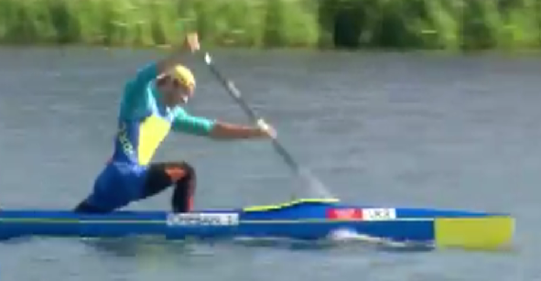
Key Position 1 –Recovery & Build to “SET UP”

Slide 3
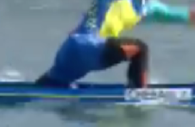
Key Position 1 –Recovery & Build to “SET UP”
Relaxed rhythmical movement
Paddle side hip leads the stroke moving down and rotating forwards
Offside hip moves down then holds position once front knee is at 90 degrees (keep front foot light)
Paddle side hip rotates around off side hip
Shoulders counter rotate – paddle side forward – offside backwards
Blade travels close to water 3-5 cm

Slide 4
Key Position 1 – Tricks & Tips
Lunge
Straight Arm Swing
Swing – Cross Bow

Slide 5
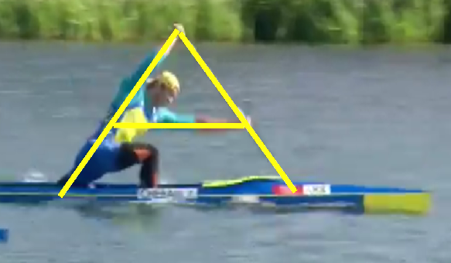
Key Position 2 – “SET UP” for the “CATCH”

Slide 6
Key Position 2 – “SET UP” for the “CATCH”
Fully extend and rotate to create the “A” frame (neutral lines)
Tension the frame
Keep weight on kneeling (keep front foot light)

Slide 7
Key Position 2 – Tricks & Tips
Imagine Egg Under Front Foot
Look Under Top Arm

Slide 8
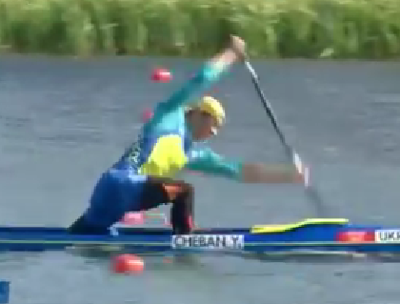
Key Position 3 – The “CATCH”

Slide 9
Key Position 3 – The “CATCH”
HOLD the Frame - HOLD the Rotation -HOLD the Tension
Pivot upper body from Hips(keep front foot light)
Transfer body weight from kneeling knee to blade
Blade enters forward – “DYNAMIC & HIGH IMPULSE ACTION”
Bury blade quickly (upper body drops as one)
HANG on the blade (like pole vault)

Slide 10
Key Position 3 – Tricks & Tips
Two Knee or Short Step Paddling
Paddle from Standing

Slide 11
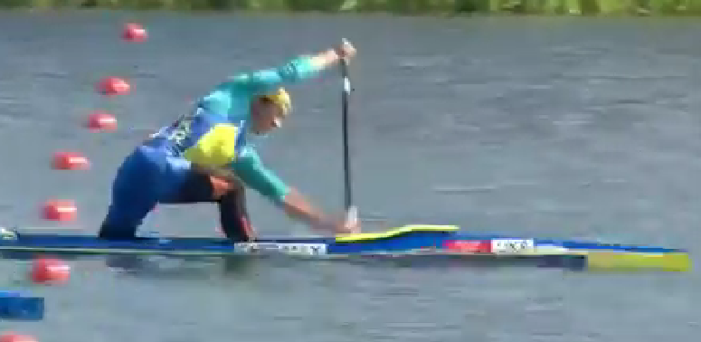
Key Position 4 – “DRIVE 1”

Slide 12
Key Position 4 – “DRIVE 1”
HOLD the Frame – HOLD the Tension
Paddle side hip leads the stroke by rotating backwards
HANG on Blade & PRESS down with both hands

Slide 13
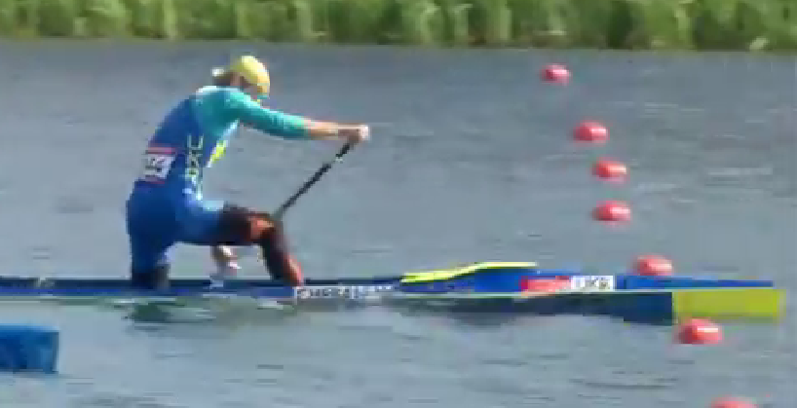
Key Position 5 – “DRIVE 2”

Slide 14
Key Position 5 – “DRIVE 2”
HOLD the Frame – HOLD the Tension
HANG on Blade & PRESS down with both hands
PUSH with front foot
Start to rotate paddle side hip forwards (hip leads the stroke)
Connect through kneeling knee
Upper Body Lifts
Close the hip/knee to blade “DYNAMIC ACTION”

Slide 15
Key Position 4 & 5 – “DRIVE 1 & 2” Tricks & Tips
Resisted work on Water
Use of Ergo
Bank Work

Slide 16
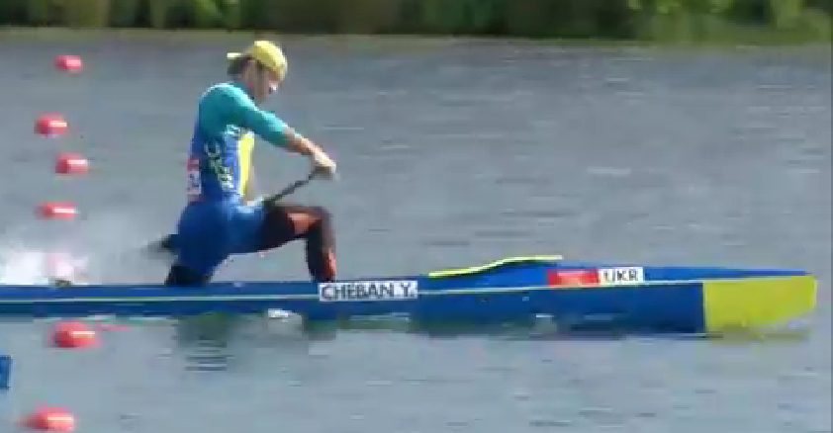
Key Position 6 – “STEERING & EXIT”

Slide 17
Key Position 6 – “STEERING & EXIT”
HOLD the Frame – HOLD the Tension
Angle blade to steer
Blade Exits when bottom hand and paddle side hip meet
At Exit elbow brakes on bottom arm top arm remains straight
Blade Exits forward aided by the hip & body rotation

Slide 18
Any Questions ?

