Slide 1
Developing Power: The FUNdamental Years
Matthew.Thompson@eis2win.co.uk

Slide 2
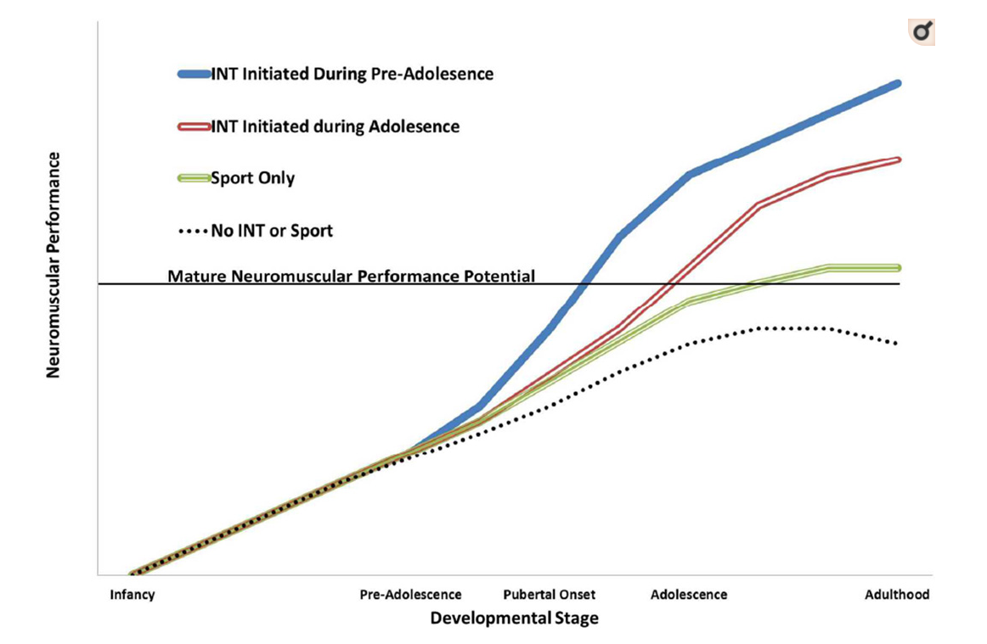
Why?
Jumping 6xbody weight landing force
Acceleration/Deceleration Force
Water Volume
Repeated Effort >90s
Extreme Range
Notes:
However overuse injuries are common. Due too to much to soon.
Attempting to prepare them for the demands of the sport. We know that during growth a deconditioning effect occurs without the an intervention in neuromuscular and muscular skeletal can result in disfunction and injury risk.
Things to consider: safety, correct technique, appropriateness of the methodology.

Slide 3
Glossary
Growth- Quantifiable changes in body composition/ size of the body
Maturation- progress towards maturity
Peak Height Velocity- Reflects the maximum acceleration of growth during adolescence
Notes:
Growth occurs as a results of increase in cells. More muscle mass
Maturation defines a fully functioning reproductive system or skeletal system. occurs at different rate in all individuals. Not all systems mature at the same time and differ between gender. Therefore it is difficult to measure. A common method is use PHV
PHV can help to identify the start of adolescents with the start of growth and end when growth stops.

Slide 4
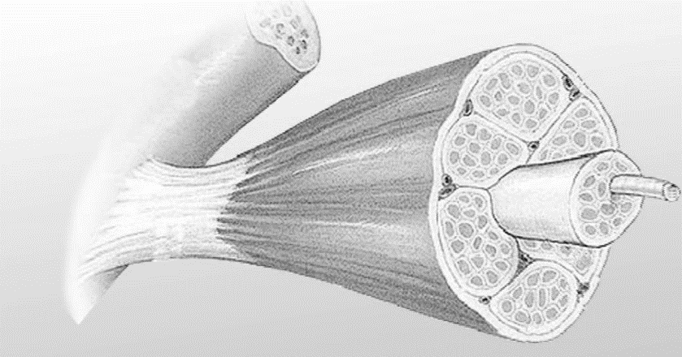
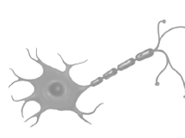
Changes and Impact
Bone Mass + Remodelling
Muscle CSA + Co-contraction
Tendon develops at a different rate to muscle
Fibre Recruitment less efficient
(75% vs 95%)
Notes:
We know bone and muscle growth plays a significant role in force production and therefore understanding the changes that occur are vital.
Bone mass- bones grow first before muscles causing the muscle to stretch. Which can result in decreased coordination. increase in mass and density greatest during prepubertal phase. Weight bearing activity could promote changes that reduce risk of osteoporosis.
Muscle CSA- lower levels of testosterone pre puberty.
Reduced firing of muscle fibres. inability to activate their muscles to the same extent as adults
Co-contraction for both muscles a may create more joint stability but at a higher energetic cost of just one activating.
Tendons- grow
Nervous systm develops post puberty

Slide 5
Gender Differences
Pre pubertal years no difference
Earlier Onset of Adolescent (~2yr)
Menstrual Cycle Commencement
Knee Valgus
Joint Laxity
Increased Oestrogen
Greater Magnitude of Growth Spurt
Greater Resting Hormone levels
Greater Increase in Muscle Mass
VS
Notes:
No difference in maturation but bone growth is at its greatest
What is not quested is the use of resistance training in both genders during growth to increase strength and reduce injury. Female research suggests reducing in particularly knee injuries
Oestrogen increases fat storage and also lower muscle mass.

Slide 6
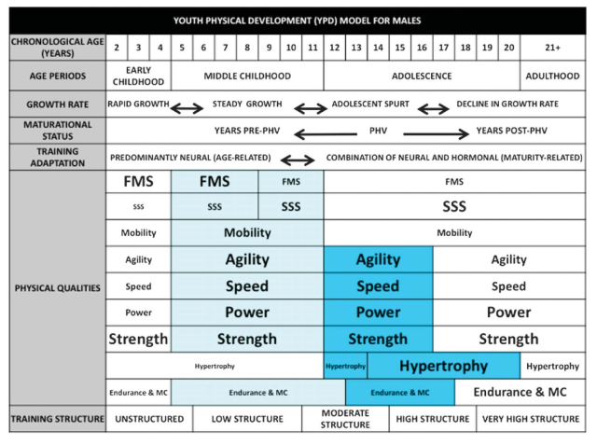
Windows of Opportunity
Competency Based
Notes:
Motor skill competency is also enhanced during childhood. As the brain develops and is mailable key time to learn new skills and how to coordinate properly. In adequate efficiency is often related to early specialisation e.g. how many rowers can catch and pass? How many canoeists can run/kick a ball?
Around PHV you get adolescent awkwardness.
It is
Periods around PHV where resistance training can be increases in volume but only in well conditioned athletes. Due to increase in mass and testosterone.
Is relative strength an appropriate if an athlete is increasing mass at an increased weight but not inline with increases in strength.

Slide 7
Slow Cook not Flash Fry
Bigger Potential
Notes:
Trying to organise the biological systems to enhance performance. Have high capacity and efficiency in key
Platform to perform- ability to produce force. Systems ability to contract harder. Looking after the muscle and tendon. Robustness
Attempting to prepare them for the demands of the sport. To many are

Slide 8
Volume
Apply force Repeatedly
Training Age
Apply force
Intensity
Capacity to Reproduce
Movement skills
Functional Competence
Notes:
Luke will talk about driving strength but then widening out. As a development programme we are trying to give them the tools be able to develop force. This starts with can you do the movement if not why not? Then can you reproduce the movement efficiently, then can you apply for in that position? Then can you apply force in that position repeatedly?
3yrs to truly start strength training before that is coordination training, then building enough CSA to give the system the ability to apply force.
If we skip the bottom bit and head straight to the top the ceiling for adaptation will be limited. Short term gain for long term pain?

Slide 9
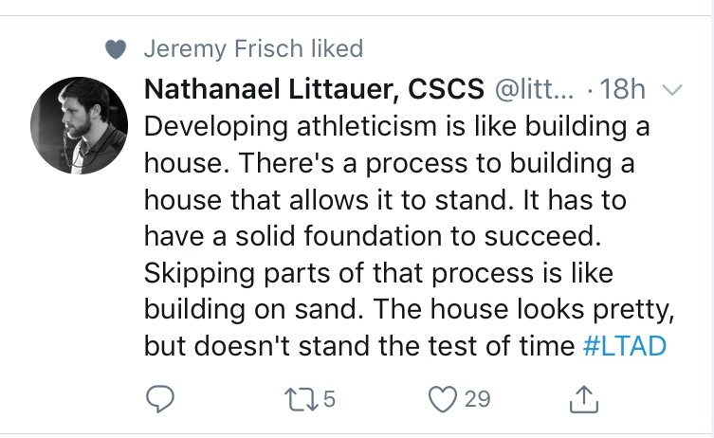
Volume
Apply force Repeatedly
Training Age
Apply force
Intensity
Capacity to Reproduce
Movement skills
Functional Competence
Notes:
Luke will talk about driving strength but then widening out. As a development programme we are trying to give them the tools be able to develop force. This starts with can you do the movement if not why not? Then can you reproduce the movement efficiently, then can you apply for in that position? Then can you apply force in that position repeatedly?
3yrs to truly start strength training before that is coordination training, then building enough CSA to give the system the ability to apply force.
If we skip the bottom bit and head straight to the top the ceiling for adaptation will be limited. Short term gain for long term pain?

Slide 10
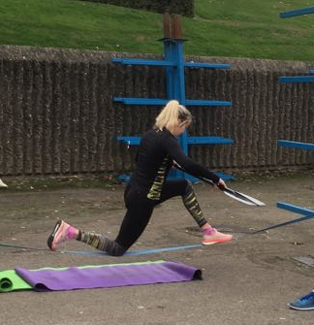
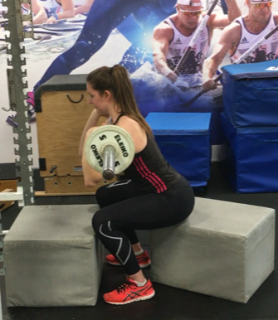
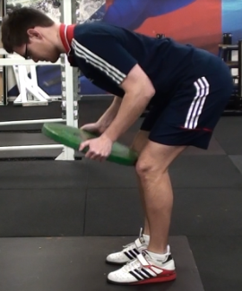
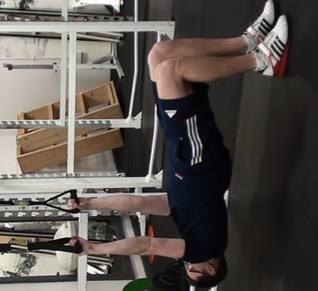
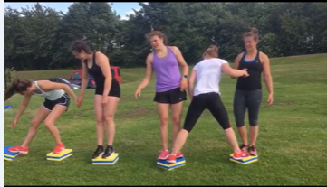
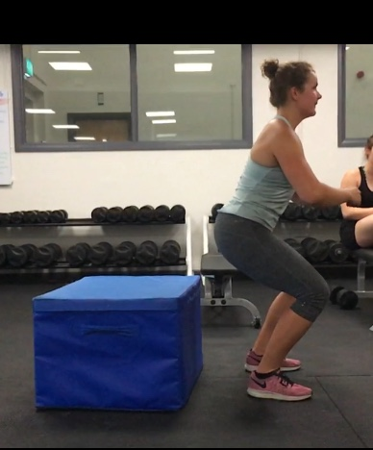
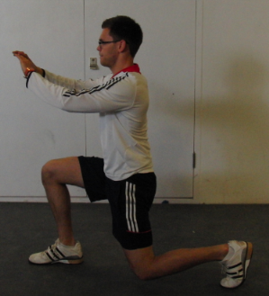
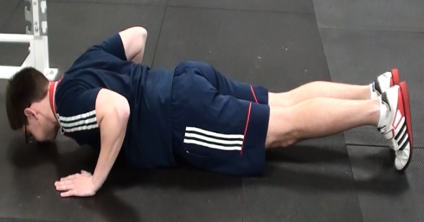
Stability
Capacity
Coordination
Movement
Notes:
Programme should enrich motor learning experience. Bandwidth of movement variability. Allow them to find solutions to problems, give them 1000 ways to solve the problem so no matter what the problem in any condition they can find a way out.
Same on the water
Applying force in the right direction is key.
Due to increases in motor learning. The development of fundamental skills are vital.

Slide 11
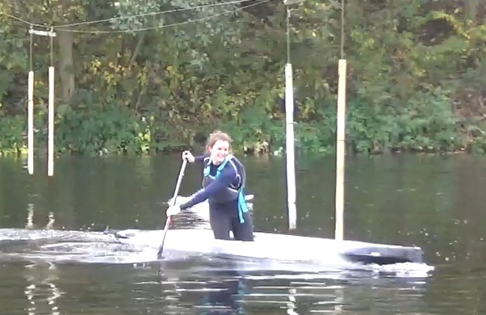
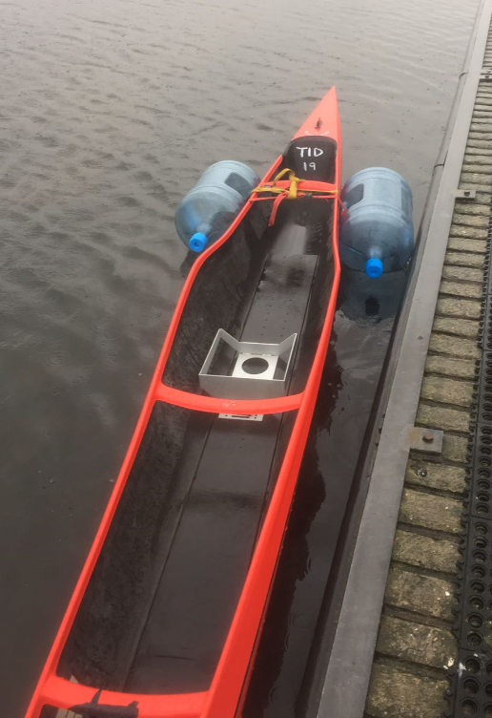
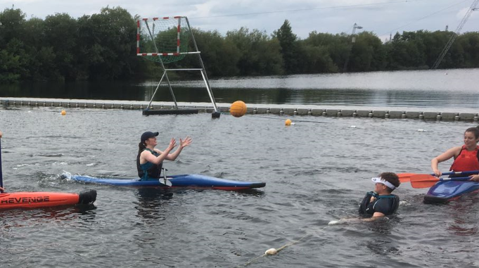
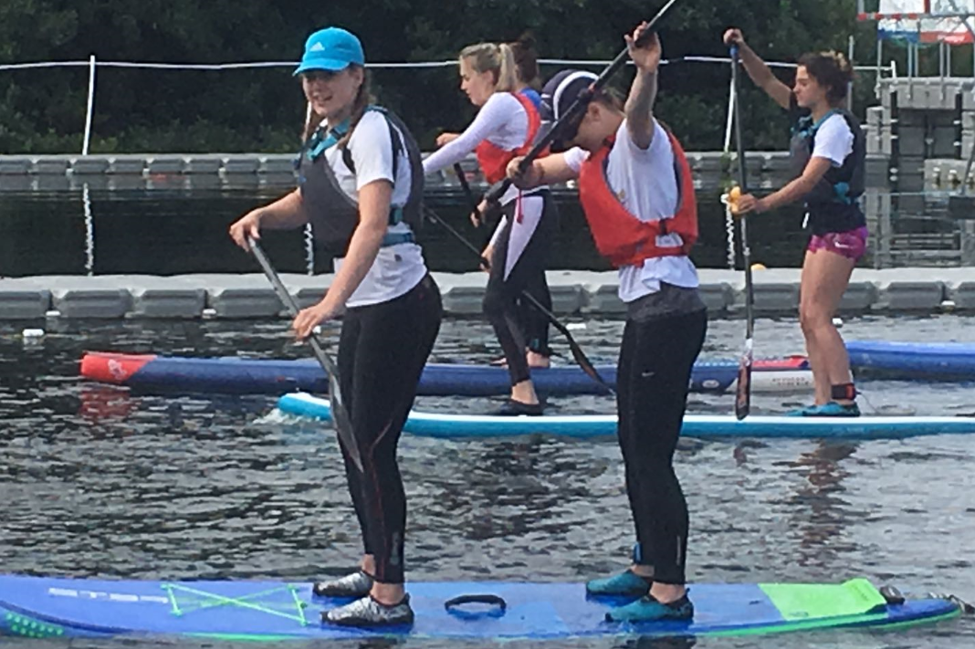
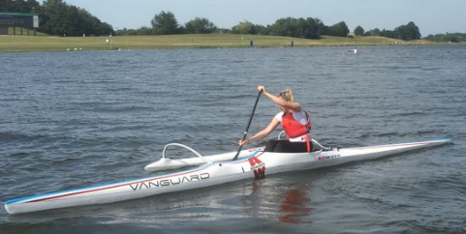
Boat Skills
Constraint
Variability
Decision Making
Adaptable
Notes:
AFH ability to adapt to conditions won her a medal at U23 euros. Her bandwidth was big and could find a solution to get down the course.
It also recreates decision makers.

Slide 12
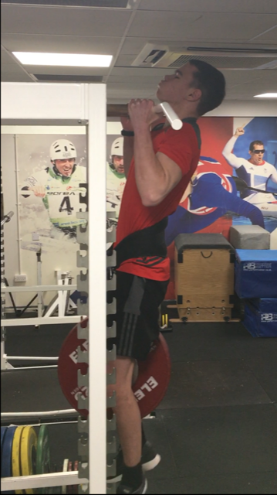
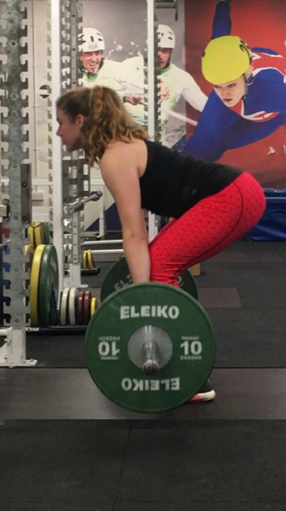
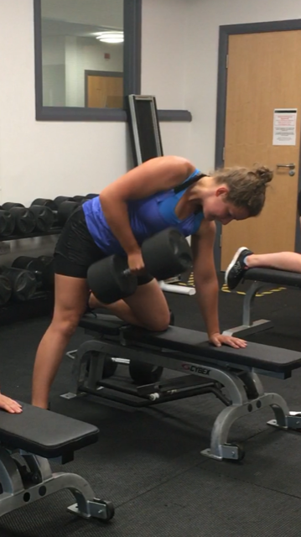
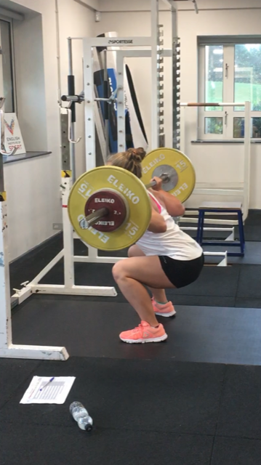
Notes:
But ultimately we are looking to load and produce force. Overload creates changes at a neuromuscular level allows the muscle to contract harder and faster. Without overload you get what you always got!

Slide 13
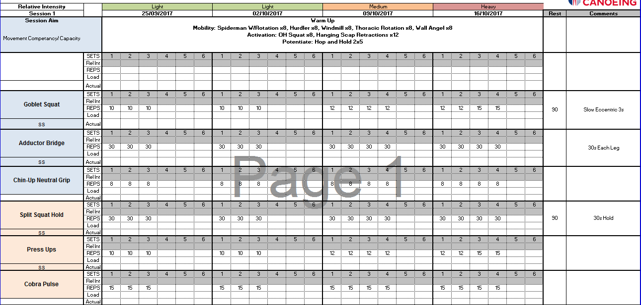
Winter
Notes:
The higher volume allows the athlete to explore the movement however when quality diminishes set is capped.
But also to build capacity and movement efficiency
2/3 session per week appear to be enough.
Variation to drive adaption but not to much that they don’t learn the skill. 2exposures vs 2exposures per week?
Volume and intensity capped at technical competency.

Slide 14
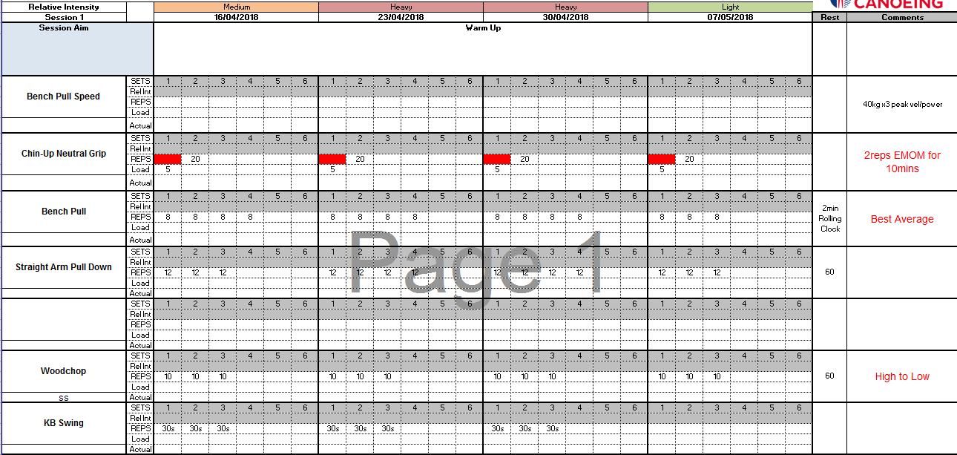
Summer

Slide 15
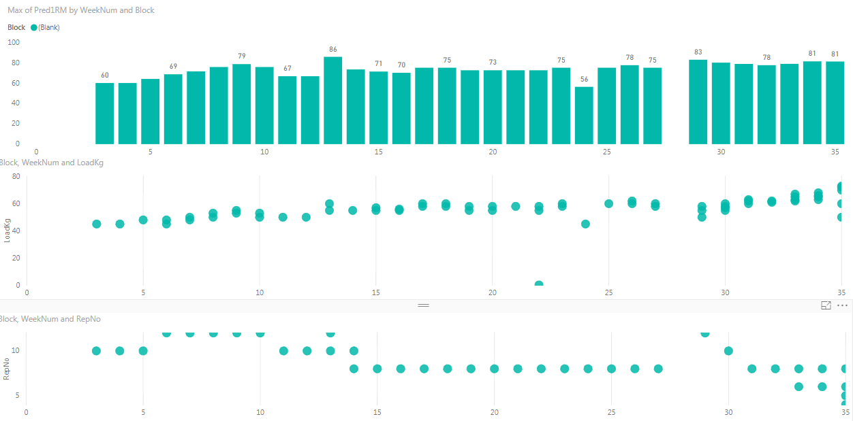
Still Increased 1Rm
Progressive overload
Volume
Notes:
Still get strong due to increase in coordination and muscle mass.

Slide 16
Take Home
Enrich Motor Learning
Competency Based
Platform to Perform

